Slide 1
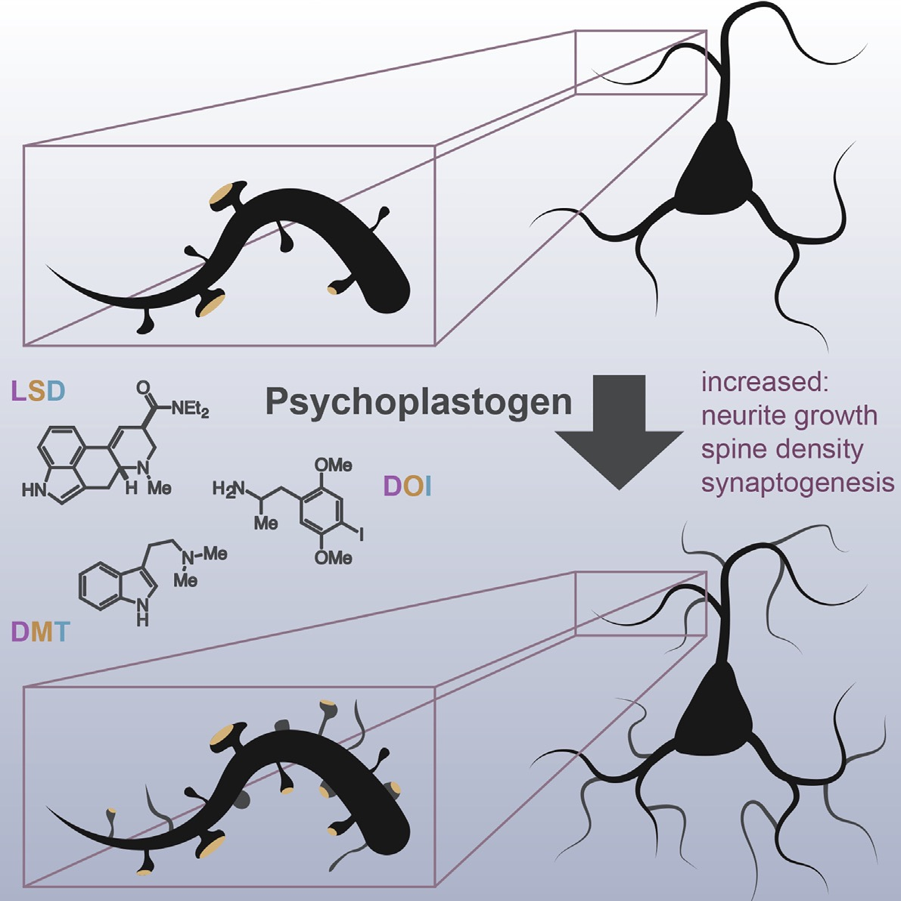
Hallucinogens for Healing:
How psychedelics may reverse stress-induced
brain deficits

Slide 2
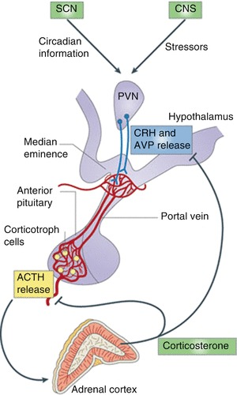
Stress
Adaptive
HPA axis activation & stress hormones
Chronic stress → Depression
Symptoms – Anhedonia, Despair, Suicide
Inadequate Treatments – 1 in 3 find relief
But…

Slide 3
Psychedelics & Depression
Single dose
Up to 6 months
Animal models: Prefrontal Cortex & Amygdala involved
Circuits & mechanisms still unknown
LSD
DMT
Psilocybin
Rapidly reduce symptoms of depression

Slide 4
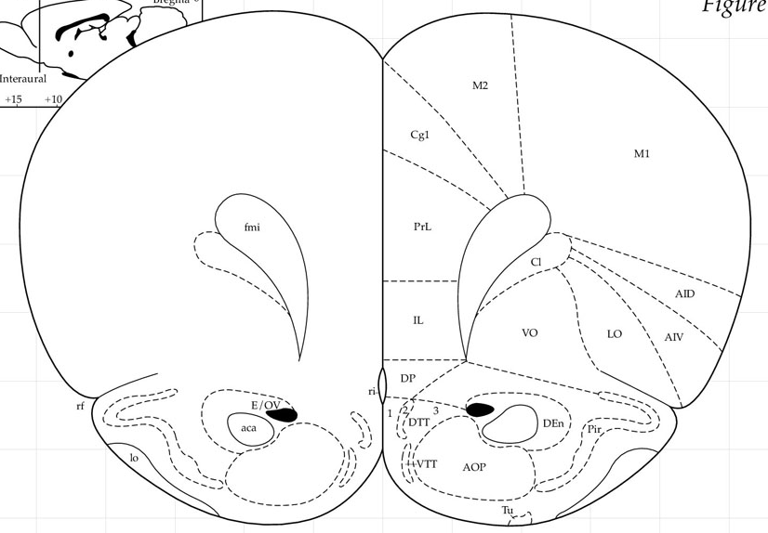
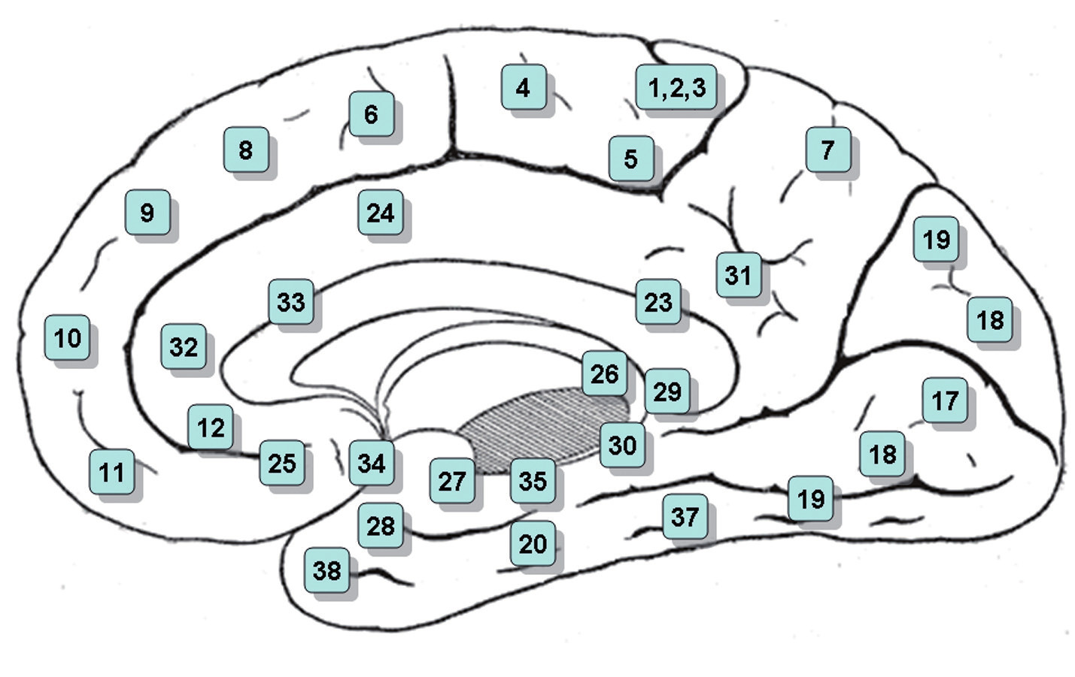
I
II /III
IV
V
VI
PrL
IL
Glu
Glu
Executive decision-making region
Regulates stress responses
Connections to the basolateral amygdala (BLA) to promote pro-stress or anti-stress behavior
IL
PrL
To BLA

Slide 5
IL
Fear extinction learning
- Requires MAPK pathway
- Consolidation protein synthesis dependent
- BDNF infusion mimics fear extinction training (w/o training)
Inhibits drug seeking behavior
PrL
Fear expression
Fear conditioning
Drug seeking behavior
PrL
IL

Slide 6
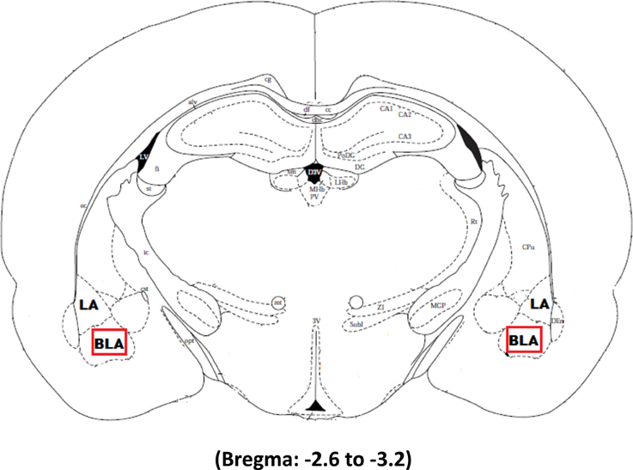
Basolateral Amygdala
From mPFC
Gates expression of emotional behaviors
Cellular changes resulting from emotional learning
Reciprocal connections with IL/PrL
LA
BLA
Glu
Glu

Slide 7
Spatially separated populations of Pyramidal Neurons (PNs) (Kim et al 2016)
Drive opposing behaviors, antagonize activation of opposing neurons
Posterior BLA (parvocellular & Ppp1r1b⁺ + CamKII⁺)
Activated by positive valence, reward conditioning
70% of NAc projections
Project to Lateral & Medial CeA
Project to Infralimbic Cortex
Anterior BLA (magnocellular & Rspo2⁺ + CamKII⁺)
Activated by negative valence, contextual fear conditioning
30% of NAc projections (negative behavior)
Project to Capsular CeA
Project to Prelimbic Cortex
LA
BLA
Glu
Glu

Slide 8
Basolateral Amygdala
+ mPFC
LA
Glu
Glu
IL
PrL
BLA
Anti-stress
Behavior
Glu
Anxious
+
Depressive
Behavior
Glu

Slide 9
BLA to
Central Amygdala (CeA)
LA
mITC
lCeA
mCeA
BLA
GABA
lcCeA
PAG
Mc
dl/lPAG
GABA
Glu
Ach
From IL
GABA
GABA
Glu
vlPAG
GABA
Glu
Anxious
&
Depressive
Behavior
From PrL
Anti-stress
Behavior
Glu
Ach
Sc

Slide 10
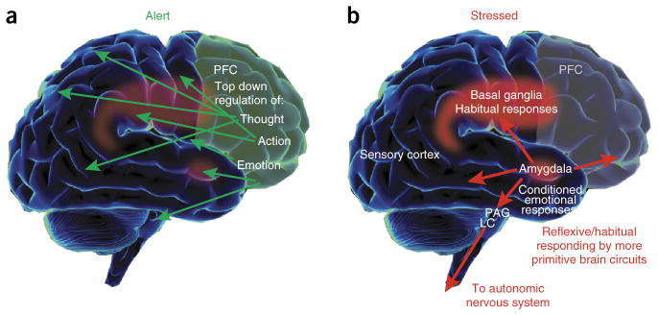
(Arnsten 2015)
Notes:
(a) Under conditions when a subject feels alert, safe and interested, phasic release of catecholamines strengthens the higher cognitive functioning of the PFC, thus allowing top-down regulation of thought, action and emotion. In primates, the PFC is topographically organized, with the dorsal and lateral surfaces mediating attention, thought and action while the ventral and medial aspects mediate emotion. The anatomical projections of these areas reflect these specializations. (b) During stress exposure, high levels of catecholamines take the PFC ‘off-line’ while strengthening the functions of more primitive circuits—for example, the conditioned emotional responses of the amygdala and the habitual actions of the basal ganglia. The amygdala activates brainstem stress systems, which in turn activate the sympathetic nervous system.

Slide 11
(Song et al 2017)
BDNF can be synthesized in astrocytes, microglia, presynaptic and postsynaptic dendrites
Bdnf gene has 9 unique promotors that drive transcription of at least 20 different transcripts than encode for an identical protein
Spatial code hypothesis speculates differential expression of Bdnf transcripts enables local spatial, temporal, and stimulus-specific BDNF production.
Notes:
Each variant consists of a 5′ untranslated region (UTR) exon that is alternatively spliced to a downstream common coding exon.

Slide 12
(Baj et al 2011)
Upon cortical/hippocampal neuron activation
Exons 1 and 4 localized to proximal dendritic regions (primary dendrites 60 µm away from soma)
Exons 2 and 6 (L-3’-UTR) localized to distal dendrites (60 µm and further from soma)

Slide 13
(Tripathi et al 2019)
Lesioning the BLA prior to stress prevents stress induced changes to PFC
Temporary BLA inactivcation during stress as well
(Cerqueira et al 2007)
4 weeks of CUS resulted in reduced volumes in layers I/ II of IL, PrL and ACC
Knockdown of astroglial glutamate
transporters in IL induces depression
(Fullana 2019)
Chronic Stress → alteration of microglia morphology in IL, PrL, AC, MeA….
Chronic Stress → persistent ↑ in
BLA Bdnf
*even after stress stops

Slide 15
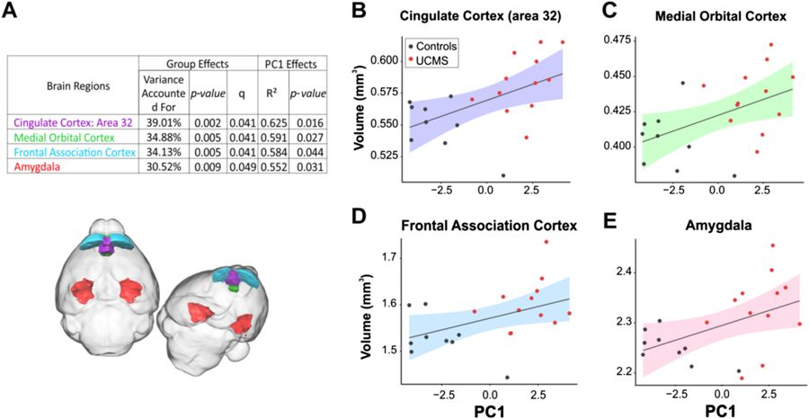
Unpredictable Chronic Mild Stress
(5 weeks, 3-4 random stressors per day)
UCMS induced behavioral changes correlate with increased size of (MRI)
Prelimbic Cortex
Medial Orbital Cortex
Frontal Association Cortex
Amygdala
Increase amygdala size showed greater expression of postsynaptic maker PSD95
Nikolova et al. 2018

Slide 16
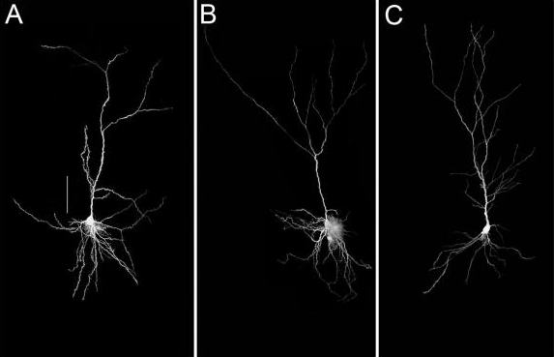
Chronic Restraint Stress Structural Changes
(Goldwater 2009)
(Layer V IL neurons)
(6 hrs for 21 days)
1. Dendritic retraction 240 μm from the soma in CRS group
2. Proximal dendritic extension was seen 120 μm in rest group (21 days post CRS)
Didn’t occur in AC or PrL
3. Spine density unchanged
Chronic
Restraint
Stress
Rest
Control

Slide 17
Chronic Restraint Stress Structural Changes
(Goldwater 2009)
(Layer V IL neurons)
(6 hrs for 21 days)
D1 mediated plasticity lost in CRS due to downregulation
Regained in rest group
Dense VTA DA innervation in layers V-IIII in mPFC (Vincent 1993, Bergeson 1995)
High D1R localization on apical dendrites and postsynaptic spines
Control
Chronic
Restraint
Stress
Rest

Slide 18
Control
stress
Chronic Restraint Stress Structural Changes (mPFC)
Thin
tuft
(20 minutes for 7 days)
Stress ↓ frequency of 5-HT + Orx induced EPSPs
Disconnect apical tuft (b)
80% reduction of 5-HT EPSP
60% reduction of Orx EPSP
Thick
Tuft
Liu & Aghajanian 2008

Slide 19
Chronic Restraint Stress Structural Changes
Stress →↑ distal & intermediate dendrites
Stress →↓ distal & intermediate spines
Liu & Aghajanian 2008

Slide 20
Chronic corticosterone (100 mg/ml in drinking water for 7 days)
Glucocorticoid Receptor antagonist prevents CRS structural and 5-HT stress induced changes
Not Orx
Liu & Aghajanian 2008

Slide 21
(Csabai et al 2018)
9 weeks chronic mild stress
(excitatory)
↓ IL volume
↓ # excitatory synapses
↓ # myelinated axons
(Layers III—VI)
(inhibitory)

Slide 22
(Jaggar and Vaidya 2018)

Slide 23
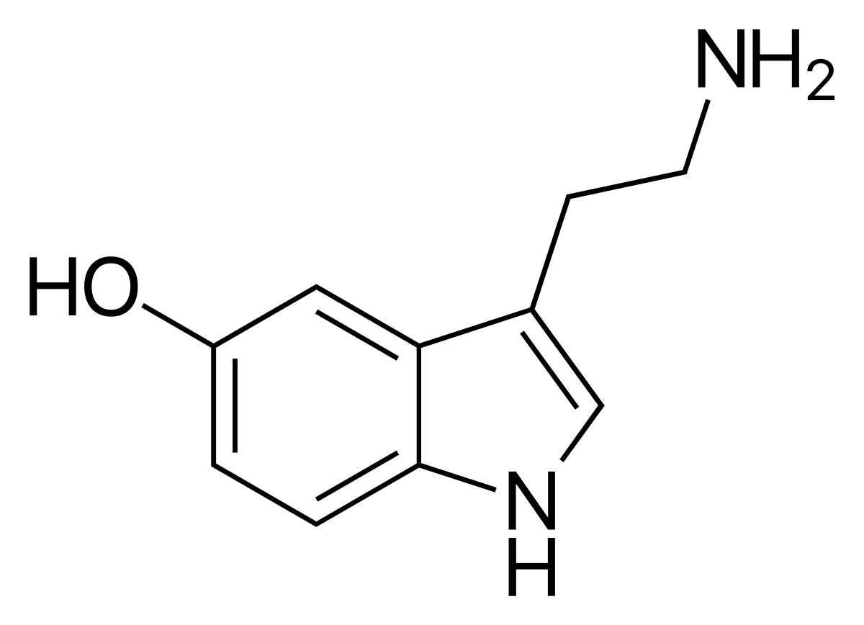
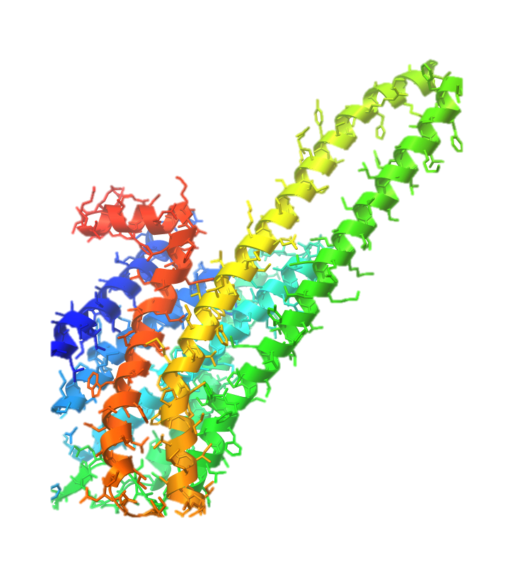
5-HT_{2A} Functional Selectivity
Serotonin
PLC
DAG
Gqα
IP3
↑ Ca⁺⁺

Slide 24
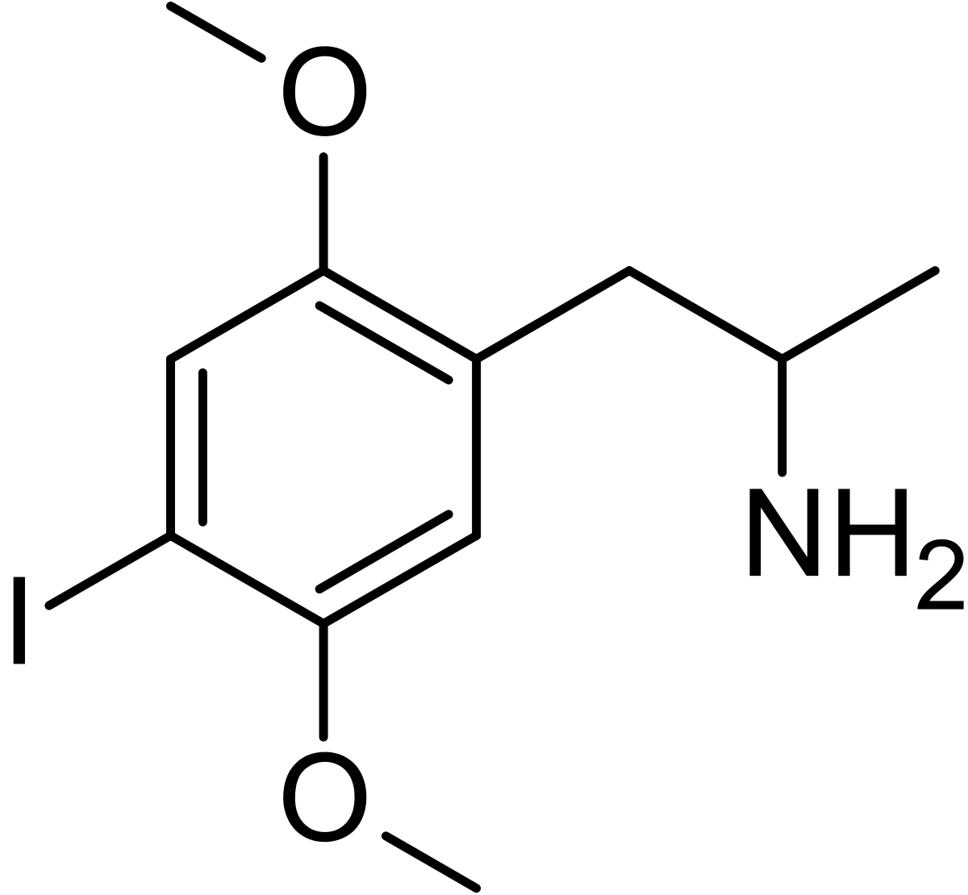
5-HT_{2A} Functional Selectivity
Serotonergic
Psychedelic (DOI)
PLC
DAG
↑ mTOR
Gqα
CREB
Akt
TrkB
IP3
↑ BDNF
GRK
↑ Ca⁺⁺
ERK
Β-arrestin
ERK
MEK
Raf

Slide 25
Chronic Stress + mPFC
Dorsal Raphe
= 5-HT_{2A}
I
II /III
IV
V
VI
Serotonin
= AMPA+NMDA
Glutamate
Midline/intralaminar
thalamus
= Orx₂
Orexin A/B
Lateral Hypo.
Glu
BLA
Anti-stress
Behavior
IL (layer V)

Slide 26
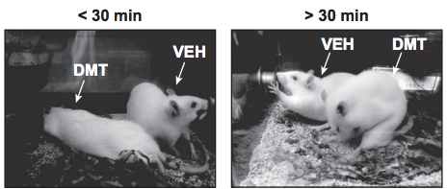
Antidepressive effects of DMT
10 mg/kg ip (hallucinogenic dose)
Behavioral tests performed
1 hour after administration
Notes:
No headtwitch response

Slide 27
1 hr
NIL
↓ Exploratory behavior
↓ Total distance moved
↓ Rearing
FC
↑ Cued fear extinction (not contextual)
FST
↓ Immobility
↑ Time swimming
EPM
↓ Time in open arms
↓ Open arm entries

Slide 28
Primary cortical cultures Sprague-Dawley rats (E18)
↑ dendritic arbor complexity
↑ # of dendrite branches
↑ # of primary dendrites
↑ total dendrite length
Did not increase length
of longest dendrites
Notes:
E18 = embryonic day 18

Slide 29
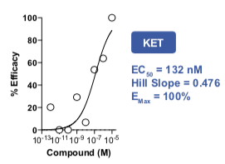
Primary cortical cultures Sprague-Dawley rats (DIV6)
Treated w/ 8 decreasing concentrations of compounds
(10-fold dilutions)
Notes:
DIV6 = day 6 in vitro
The Nmax values obtained following treatment with 10 μM ketamine and vehicle (0.1% DMSO) were defined as 100% and 0% respectively

Slide 30
Mature primary cortical cultures Sprague-Dawley rats (DIV19)
Treated w/ compounds for 24 hrs
Blue
MAP2 (dendrite shaft)
Yellow
F-actin (all processes)
Mature primary cortical cultures
Sprague-Dawley rats (DIV19)

Slide 31
Green
Presynaptic terminal
Magenta
Postsynaptic terminal
Yellow
Dendritic shafts

Slide 32
↑ Spine
density
↑ Synapse
density

Slide 33
↑ sEPSP frequency
↑ sEPSP amplitude

Slide 34
Primary cortical cultures Sprague-Dawley rats (DIV18)
24 hour treatments → ↑ BDNF Protein levels but not transcript

Slide 35
Effects blocked by inhibiting
5-HT2A, TrKB, & mTOR

Slide 36
In vivo
10mg/kg DMT (ip) → 24hrs
↑ # of spines

Slide 37
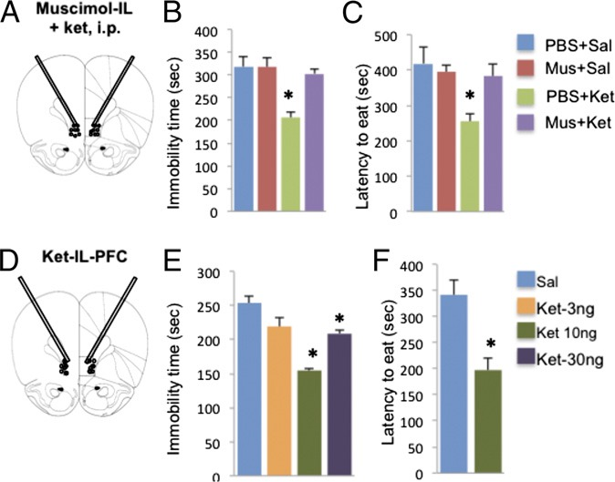
Muscimol (GABA agonist)
pretreatment blocks Ketamine antidepressive effects
Ketamine microinfusions into the IL mimics antidepressive effects of systemic administration

Slide 38
rAAV2/CaMKIIα-ChR2 (H134R)-eYFP - Target Glu PNs
Optogenetic stimulation
enhanced cell activation
in the IL as well as in the PrL

Slide 39
*The antidepressant effect of IL optical stimulation in the FST
was still present 17 d after the stimulation
None of these antidepressive changes seen with PrL photostimulation

Slide 40
(Layer V IL)

Slide 42
Basolateral Amygdala
+ mPFC
(Liu et al 2015)
LA
= CRF₁
Glu
Glu
IL
PrL
BLA
Anti-stress
Behavior
Glu
Anxious
+
Depressive
Behavior
Ketamine enhances CRF induced EPSPs
on basal dendrites of PrL and AC but NOT IL
Rapamycin blocks effects
Chronic stress does not impact CRF induced
EPSCs in basal dendrites but reduces apical
dendrites
Ketamine enhances apical response of all mPFC regions
IL, PrL, AC
Glu

Slide 43
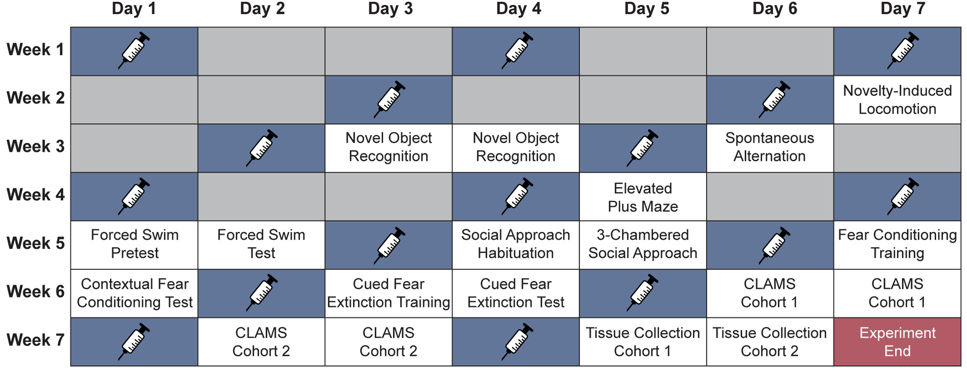
Chronic intermittent doses of DMT (1mg/kg)

Slide 44
No increase in anxiety in EPM or NIL
Males + Females

Slide 45
DMT treatment enhanced extinction memory retrieval
No impact on contextual or cued fear memory
DMT antidepressive effects in FST
No effect on working/short-term memory or Social Interaction

Slide 46
↓ Dendritic Spine density in ♀
(Layer V mPFC)
No change in mPFC gene expression
BDNF, ARC, 5-HT_{2A}, Fos, EGR1+2,

Slide 47
(Martin & Nichols 2016)
Control
5-HT_{2A} localized to neuronal processes rather than soma
DOI
5-HT_{2A} localized to proximal processes and soma rather
Only directly activate ~5% of cortical neurons in vivo indicated by IEGs
c-fos, ΔfosB, krox20lerg2, per1
These neurons had high 5-HT_{2A} mRNA
~5-10% of GABA neurons transcriptionally activated
Astrocyte populations also activated

Slide 48
(Rajkowska 2000)
The administration of (DOI), a serotonin_{2A} dramatically increases the expression of BDNF mRNA in the rat frontal and parietal cortices in layers II/III and V/VI
Same layers in which prominent reductions in neuronal and glial density and enlargements of glial nuclei are observed in postmortem brains of depressed subjects. Thus, serotonin receptor–mediated regulation of BDNF suggests that serotonin may play a role in the neuronal and glial changes reported in the neocortex in depressed patients.
(Musazzi et al 2014) in vitro rat cortical neurons
DOI enhances transcription through Bdnf exon I and exon II, but not exon IV, promoters
enhancement in cAMP response element (CRE) driven transcriptional activation

Slide 49
(Baj et al 2011)
Upon cortical/hippocampal neuron activation
Exons 1 and 4 localized to proximal dendritic regions (primary dendrites 60 µm away from soma)
Exons 2 and 6 (L-3’-UTR) localized to distal dendrites (60 µm and further from soma)

Slide 50
(Price et al. 2019)
5-HT_{2A} 5-HT_{2C} heterodimers driven by 5-HT_{2C} protomer
Heterodimers blunt the 2A pathway
5-HT has higher affinity for 2C

Slide 51
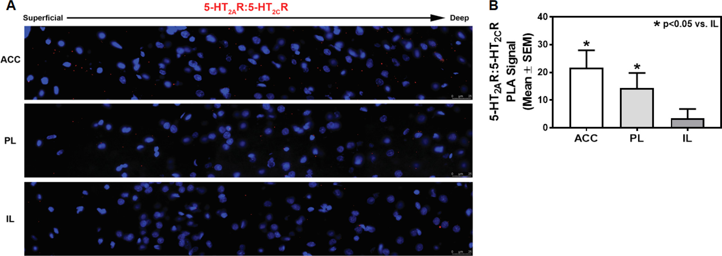

Slide 52
(Oh et al 2018)
In MDD
SST reduction & BDNF and/or TRK_{B} downregulation
Sst expression is highly dependent on Bdnf expression
Transcriptome analysis of human PFC
Expression of GABRA5 showed the highest correlation with BDNF levels
Subunit enriched adjacent to dendritic GABAergic synapses that mediates the function of SST neurons
Suggests local BDNF supply may play a role in maintaining the function of SST neurons on pyramidal cell dendrites.

Slide 53
Postmortem human MDD
Decreased L-3’-UTR-BDNF transcripts dlPFC of humans
Decreased Somatostatin, Neuropeptide-Y, Cortistatin genes (dendrite targeting)
Not Parvalbumin
7-week UCMS in mice
Decreased L-3’-UTR BDNF in mPFC
shRNA to knock down dendritic Bdnf mRNA mouse mPFC

Slide 55
Psychedelics Restore IL connectivity?
I
II /III
IV
V
VI
Serotonergic
Psychedelic (DOI)
= 5-HT_{2A}
= AMPA+NMDA
Glutamate
Midline/intralaminar
thalamus
↑ BDNF &
mTOR
Glu
BLA
Anti-stress
Behavior
IL (layer V)

Slide 56
Conclusions
Chronic Stress →
Atrophy of apical dendrites + spines
(Layer V IL neurons)
Depression
Serotonergic Psychedelics + Ketamine
Rapidly reverse depression through
Functional selectivity at 5-HT_{2A}
Chronic intermittent DMT antidepressive through disticnt mechanism
↑ Apical dendrites + spines (Layer V IL neurons)
Restore control of the BLA

Slide 57
I
II /III
IV
V
VI
PrL
IL
Glu
Glu
IL
Projects to ventral orexin fields
PrL
Projects to medial orexin fields
IL
PrL
To BLA

Slide 58
= NMDA
= 5-HT_{2A}
Mediodorsal Thalamus
= mGluR2
= Orx₂
Midline/Intralaminar
Thalamus

Slide 59
Chronic variable stress (14 days)
(Layer V IL neurons)
Genomic Glucocorticoid Receptor (GR) downregulated specifically in PV interneurons in mPFC following stress
PV interneurons most abundant, over 50% of interneuron in layer V
Usually inhibits PV interneurons, allowing layer V neurons to fire
Chronic stress downregulates GR in GAD neurons in the cortex specifically (minimal GR expression in non PV interneurons) which removes inhibition of PV, allowing them to inhibit PNs more
Increased inhibitory synapses on glutamatergic outputs in all layers of IL

